Slide 1
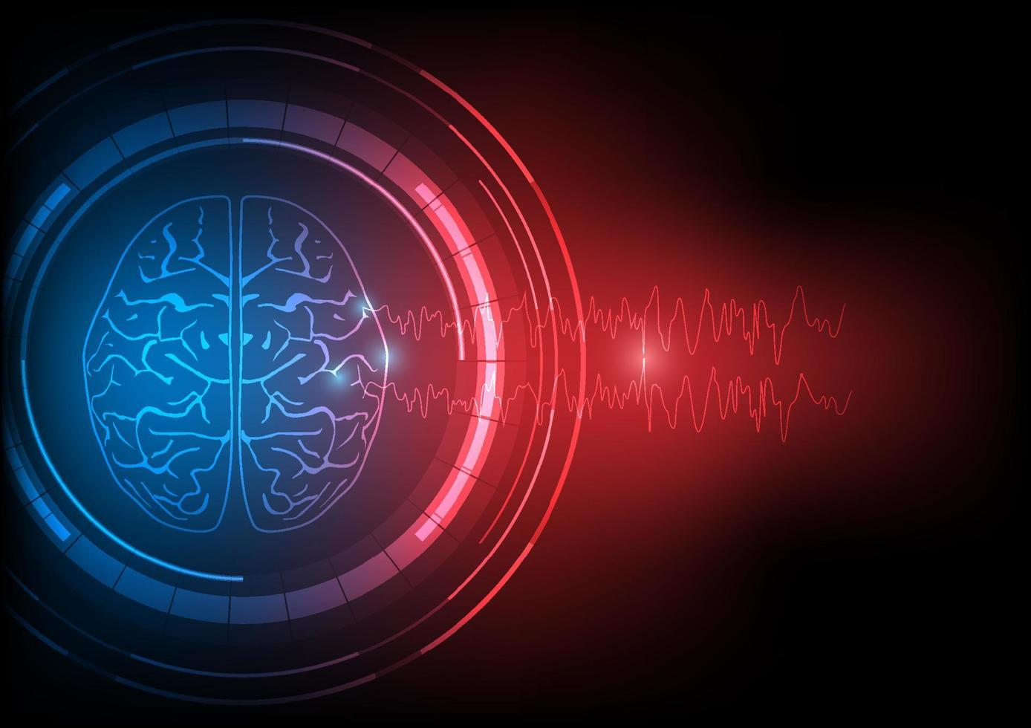
Brain Wave Classification from EEG Using Machine Learning and Deep Learning

Slide 2
COURSE: CSE499B
Group-07
Sumaiya Binte Sultana Fatema | Jubair Hossain
2021612642 | 2021626642

Slide 3
Understanding Brain Waves
EEG signals contain complex information about visual perception.
Traditional methods require manual feature extraction, limiting efficiency.
Deep learning, particularly CNNs, can automate feature learning for classification.

Slide 4
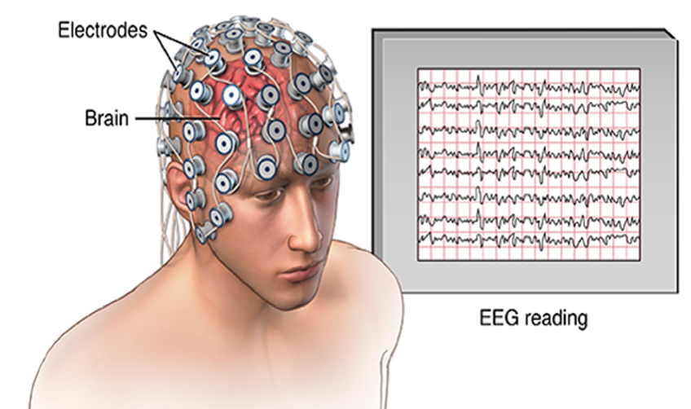
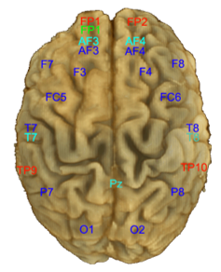
Understanding Brain Waves

Slide 5
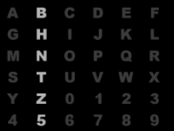
THE Dataset
BCI Competition III, Dataset II https://www.bbci.de/competition/ii/
Focus: Brain-Computer Interface (BCI) for text spelling using EEG signals
Paradigm: P300 Speller, based on the oddball paradigm
Goal: Assist individuals unable to use muscles to spell characters using brain activity
Task: Classify EEG responses to visual stimuli to detect desired characters
Training: 80%
Testing and Validation: 20%

Slide 6
Data Acquisition
EEG collected from 64 scalp channels
Sampling rate: 240 Hz
Band-pass filter: 0.1–60 Hz before digitization
2 subjects, 5 spelling sessions
Each session includes multiple runs (one word per run)

Slide 7
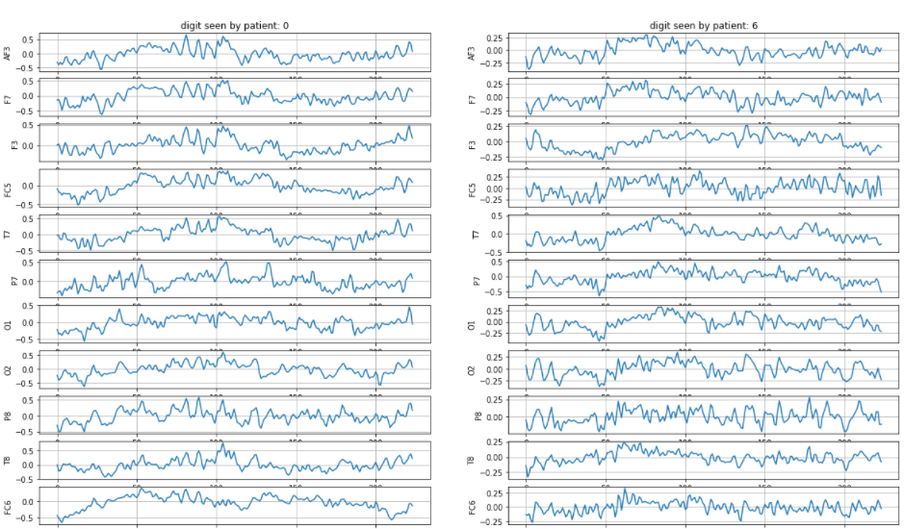
Dataset Sample

Slide 8
Classification Tasks
1. Binary Classification
Input: Post-stimulus EEG (after row/column flash)
Goal: Detect presence of P300
P300 → target stimulus
No P300 → non-target
2. Multi-class Classification
Combine results of binary classification over sequences
Identify the intended character (from 36 possibilities)

Slide 9
Literature Review – paper
01
Title: "A Deep Evolutionary Approach to Bioinspired Classifier Optimisation for Brain-Machine Interaction"
Description: The datasets for these experiments were collected using a Muse EEG headband (with electrodes placed at TP9, AF7, AF8, TP10) and the EEG MindBigData digits dataset (with electrodes at TP9, FP1, FP2, TP10).
Results and outcome:
Non-boosted DEvo MLP: 79.81% (attention), 96.11% (emotional), 27.07% (number-guessing)
Adaptive Boosted DEvo MLP: 31.35% (number-guessing)

Slide 10
Literature Review – paper
02
Title: "An Efficient Signal Processing Algorithm for Detecting Abnormalities in EEG Signal Using CNN"
Description: The study presents an efficient signal processing algorithm using a 1D Convolutional Neural Network (CNN) to detect abnormalities in EEG signals. The proposed deep learning model classifies EEG signals into normal, pre-ictal, and seizure categories without requiring manual feature extraction.
Results and outcome: Achieved 85.48% accuracy with a 14.5% error rate, outperforming traditional methods. Improved precision (76.65%), recall (78.2%), and F1-score (69.12%). CNN-based automatic detection method provides faster and more accurate EEG analysis, aiding in early diagnosis of neurological disorders.

Slide 11
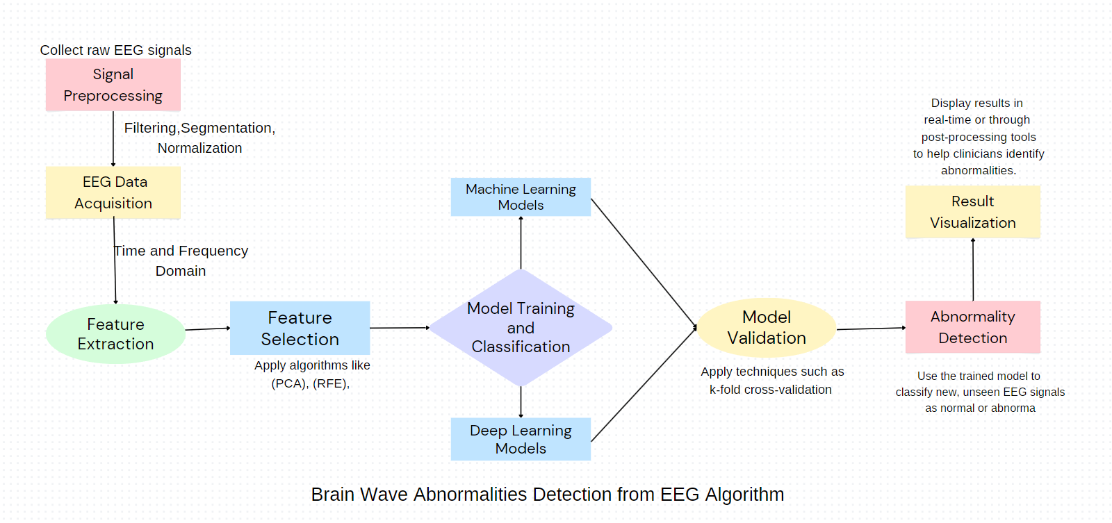
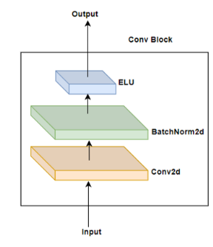
Work Process: Overview
Architecture of our CNN

Slide 12
Preprocessing steps:
Bandpass filtering (0.1–20 Hz)
Subsampling from 240 Hz → 120 Hz
Standardization and reshaping for CNN input

Slide 13
⚙️ Data Transformation
Transformed structure:
Shape: (15300, 64, 78, 1) for training
Labels reshaped to categorical format
Each EEG segment represents 0.65 seconds post-stimulus
Label: 1-hot encoded vector indicating target stimulus (12 total)

Slide 14
🧠 Model Architecture
Model Used: CNN_P300_PAMI Key Features:
Designed specifically for P300 EEG signal detection
Input: (64 electrodes, 78 time points, 1 channel)
Output: 12-way softmax classification (via binary cross-entropy loss)

Slide 15
🏋️ Training Setup
Optimizer: SGD
Loss: Binary Crossentropy
Callbacks: EarlyStopping on validation MSE
Split: 95% train / 5% validation
Batch size: 32
Epochs: up to 1000 (early stopping around 23 epochs)

Slide 16
📈 Performance Overview
Accuracy improves gradually:
Start: ~83%
End: ~85–86%
Loss reduces steadily:
From 0.45 → 0.36
Best validation accuracy: ~85.3%

Slide 17
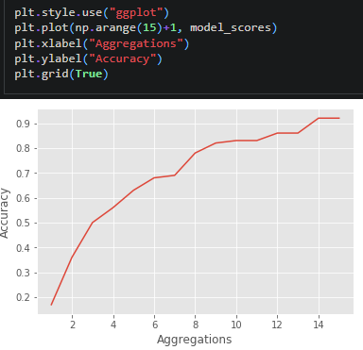
How accuracy changes across the 15 aggregation settings, labeling X as "Aggregations" and Y as "Accuracy".

Slide 18
Challenges and Observations
Data imbalance in features.
Computational requirements for deep learning.
Noise in raw EEG data.

Slide 19
Conclusion & Future Work
CNN effectively learned to classify P300 responses
Preprocessing pipeline crucial for noise reduction
Future ideas:
Try LSTM/Transformer-based models
Cross-subject generalization
Real-time BCI integration

